Slide 1


2026–2031 & beyond
- - - - -
Awards Evening
Notes:
Thanks everyone for coming. Tonight isn't just about the awards, although we'll obviously get to those. There's quite a lot I want to talk about because we're at a bit of a turning point as a group.
We've grown a lot over the last few years and that brings opportunities, but it also brings challenges.
So tonight I want to talk about where we're going, what we're planning and probably most importantly, how we're going to make it work
There's quite a lot to cover. I promise I'm not aiming for death by PowerPoint!
Some of this is about things we're doing immediately and some is about where I want us to be in five years' time.
And there's a couple of things tonight that I think will make a really positive difference to families.

Slide 2
Pre - Intro
No increase in membership fees this year.
  We've absorbed the increases in our costs this year.
    . Thanks to:
      Fundraising
      Grants
      The big increase two years ago
  But there has been….
    Increase of £5pp for hut use
    Increase of £0.50pp for capitation
Notes:
I want to start with something quite important.
I know the last time we got everyone together, it was to announce the big increase in fees. That is not the case this time as there is no increase in membership fees this year.
That doesn't mean our costs haven't gone up. We've had an additional £5 per person for hut use and a 50p increase in capitation.
We've decided to absorb those increases this year rather than pass them on to families.
We've been able to do that because of the fundraising we've done, the grants we've secured and, importantly, because of the increase we made to fees two years ago.
So when we talk about fundraising tonight, this is one of the reasons why it matters."

Slide 3


Intro
Tonight impacts EVERYONE.
  From Beavers through to Explorers
  Our 5 year plan & beyond
  All info to be emailed and a handout at the end
2026
2031
Notes:
Everything we're talking about tonight connects back to one thing: making sure we can offer a really good Scouting experience from Beavers right through to Explorers.
We're not just thinking about next term or next year. We're starting to think about what Meltham Scouts should look like in five years' time.
And that includes the young people who are only six or seven because they'll be the Scouts and Explorers making some pretty big decisions about camps and international trips before we know it.

Slide 4

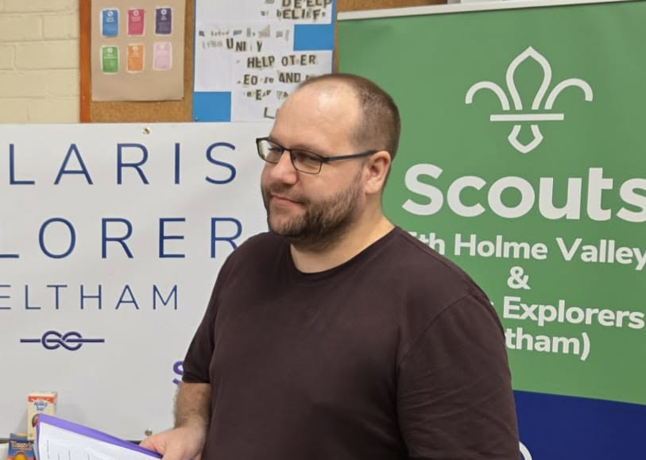
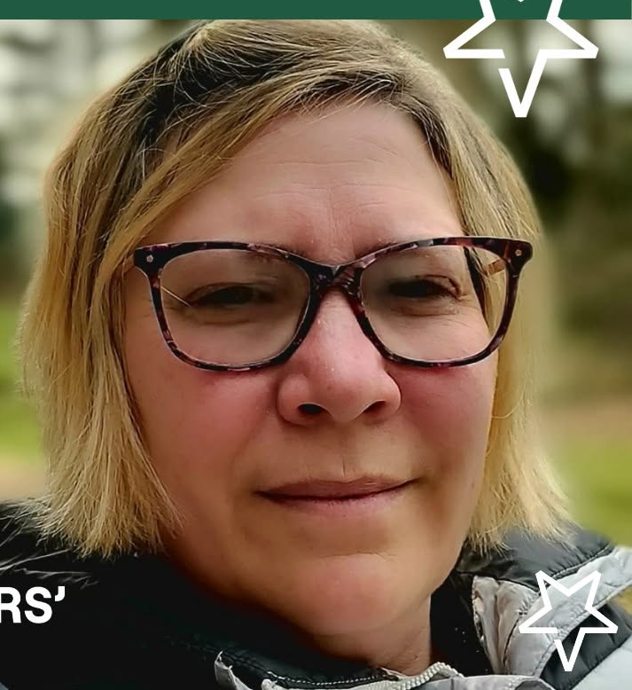
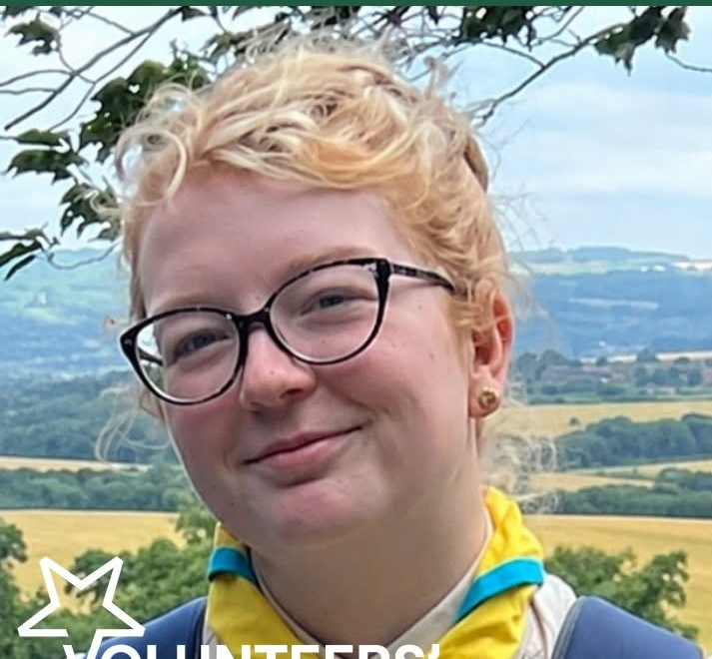
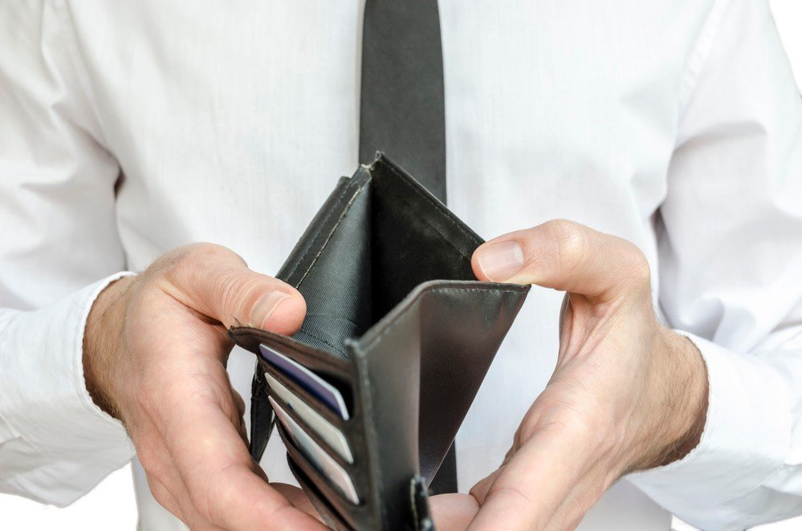

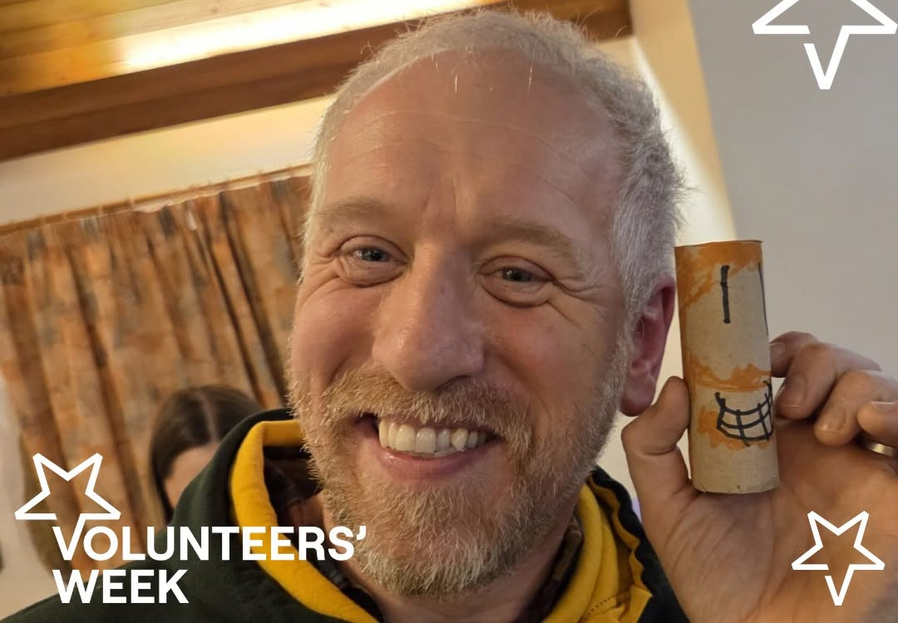
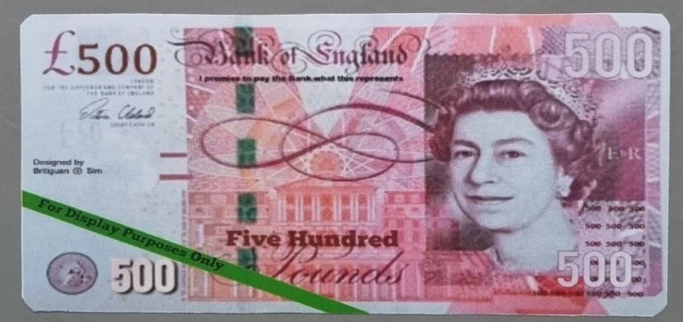
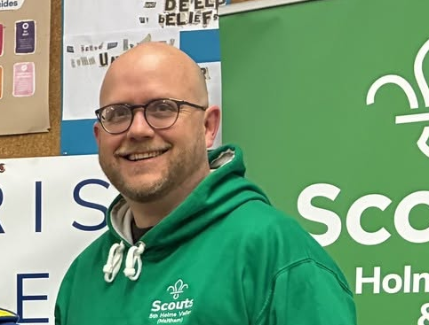
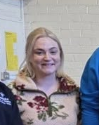
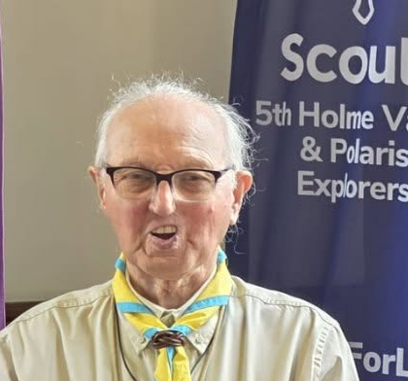
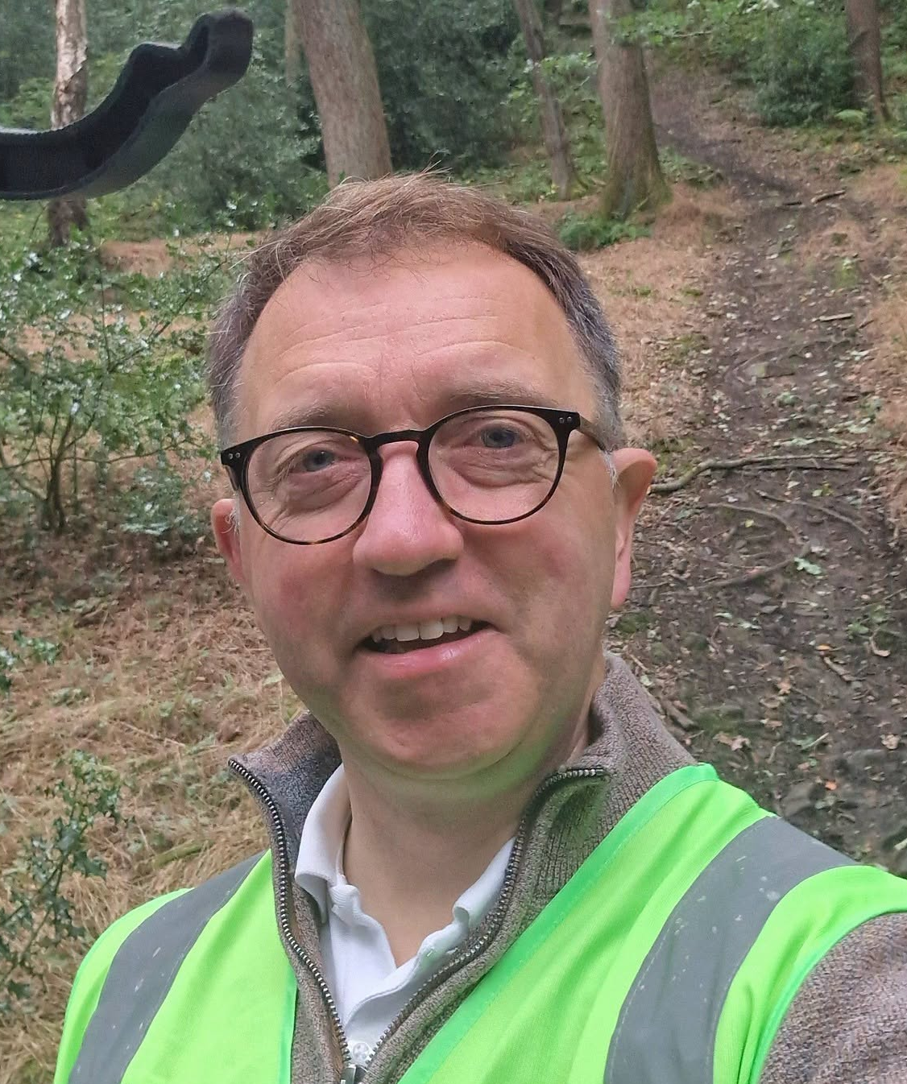
History & Timeline
2020
2022
2026
2018
2019
2023
Notes:
Everything we're talking about tonight connects back to one thing: making sure we can offer a really good Scouting experience from Beavers right through to Explorers.
We're not just thinking about next term or next year. We're starting to think about what Meltham Scouts should look like in five years' time.
And that includes the young people who are only six or seven because they'll be the Scouts and Explorers making some pretty big decisions about camps and international trips before we know it.

Slide 5
Why?
Notes:
So how do we actually make all of this happen?

Slide 6
Why 2031?
International Jamboree
  Denmark
West Yorkshire Exploration
  Unknown.
    2027 : Canada.
    2024 : Canada
    2019 : Haarlem Jamborette - Netherlands
Meltham International camp
  Open to ALL Meltham Scouts & Explorers
Then every four years in line with International Jamboree
Notes:
2031 might sound a long way away, but it really isn't.
We've already got two Explorers looking towards Canada in 2027.
We've previously had Canada in 2024 and Haarlem Jamborette in the Netherlands in 2019.
The aim is that international opportunities aren't something that suddenly appear when a young person is 16. We want families to know they're coming and give them years to prepare for them financially.
And we'd like to build towards a Meltham International Camp as part of that cycle

Slide 7
How?

Slide 8
Events & Fundraising calendar
EVENTS
  Across all sections
  To be able to plan as a family
    Timewise
    Monetary
  Events including:
    Sleepovers
    Residentials
    Camps
    Visits out
    Bonfire night (for the whole family!)
    Carols & mince pies
  Papercopy & OSM

Slide 9
Events & Fundraising calendar
FUNDRAISING
  Helps to keep costs down for events, programme and free events
    Costs in 2027 - Jamboree : £3,500. Canada : £3,500.
    Estimated cost for Meltham International : £600
  Subsidise events
  Hardship fund
    (If you need access to this, please speak to me or your section leader)
  Upgrade equipment
    New tents!
Variety of events
    Monthly coffee mornings here
    Race nights
    Quiz nights
    Beer festival
      Our newest & biggest fundraiser and we need you!
Notes:
This is something that should have been in place for years/

Slide 10

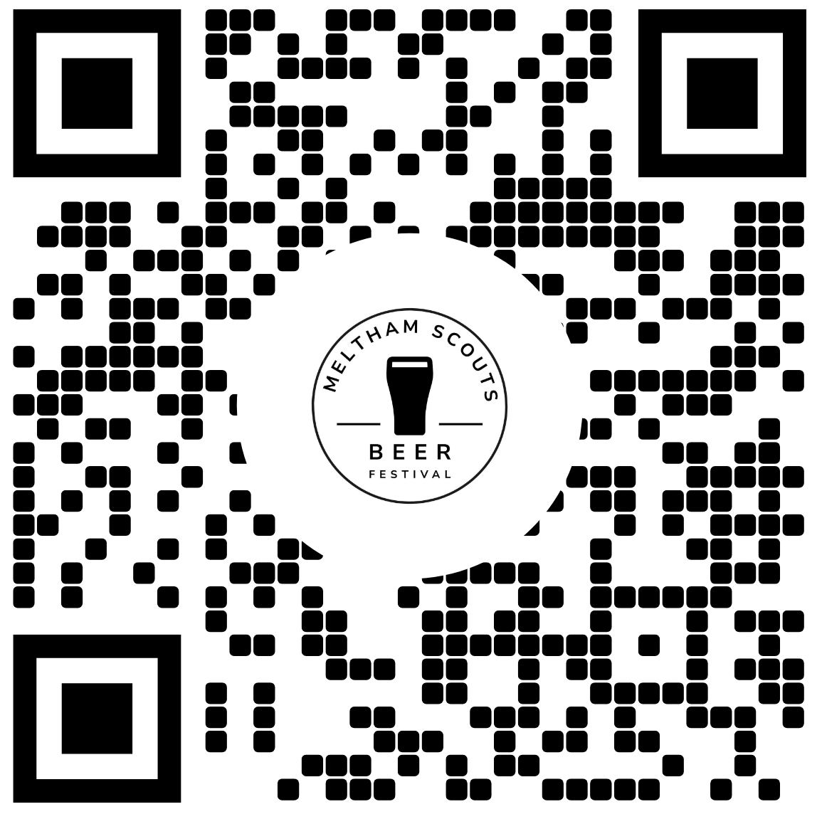
Beer Festival
Notes:
This is our newest and biggest fundraiser and it's a big one for us.
The beer festival is on 30th and 31st October here at the HQ.
We've already got our first sponsor on board and we're looking for more.
But we also need volunteers. There's going to be loads of jobs before, during and after the weekend.
So if you've got a couple of hours you can give us, please let me know.
The money raised from this isn't disappearing into a pot. It will directly help us provide activities, camps, equipment and opportunities for our young people.

Slide 11
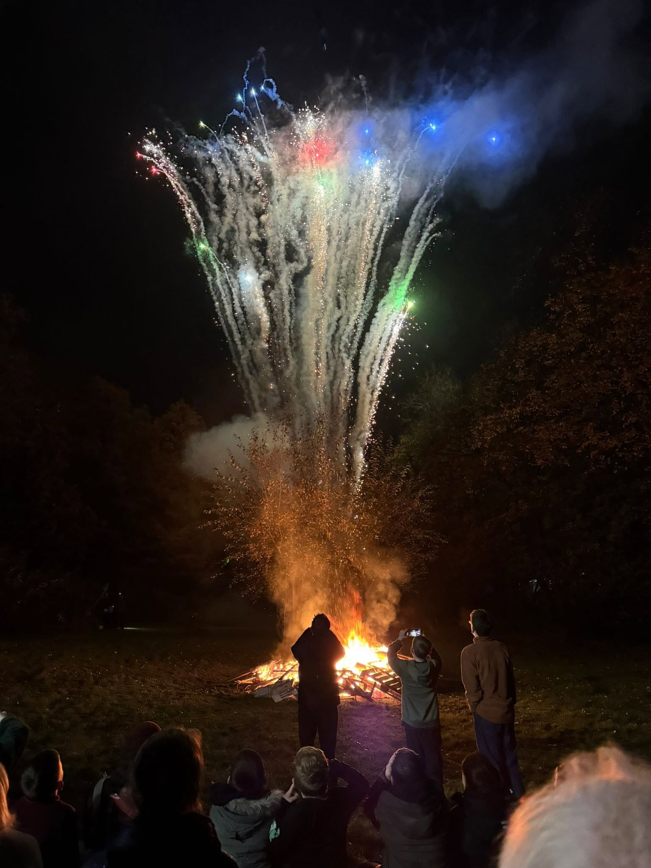
Bonfire Night
Notes:
And then we've got Bonfire Night.
This is deliberately going to be a whole-family event rather than something aimed at one section.
So bring the kids, bring grandparents, bring friends and come along.
For us, as a Group Leadership & Trustee team, It's not just another opportunity for us to raise money but also to actually spend time together as a group.

Slide 12
The Link
Notes:
What is the link?

Slide 13
Volunteering Credits
Fundraise today. Help pay for tomorrow’s adventures.
Young people and their families can take part in designated fundraising activities and build up Fundraising Credits.
Those credits can then help pay for:
Camps & residentials
Major UK Scout events
International adventures
Credits stay with the young person from Beavers through to Explorers.
Our aim: make cost as little of a barrier as possible to taking part in Scouting.
Notes:
The spoken explanation can then do the useful bit: "Imagine your Beaver is seven now. By the time they're a Scout or Explorer looking at a £500 UK event or an international trip costing considerably more, they've had years of opportunities to build up credit towards it."

Slide 14
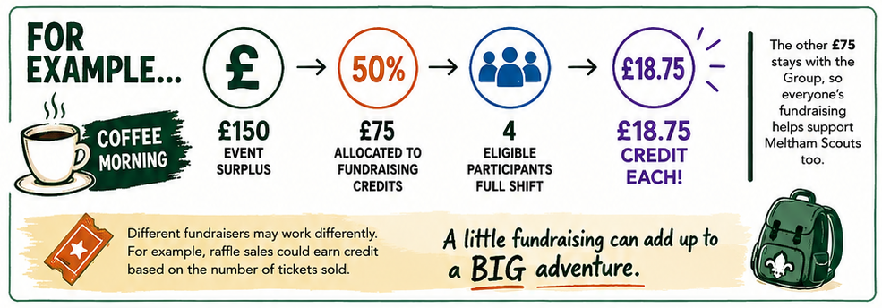
Volunteering Credits - Example
NB.
Parents/carers can fundraise too
Credits aren't cash
Fundraising doesn't affect event selection
Full details in the policy
* Separate to family rota
Notes:
"The important thing is that these credits aren't cash. They're not something you can withdraw or transfer.
They're linked to the young person and can be used towards eligible Scouting activities.
And taking part in fundraising doesn't give someone priority for an event. It doesn't affect selection.
It's simply a way of recognising the contribution families make and helping that contribution benefit the young person in the future."

Slide 15
In other news….

Slide 16
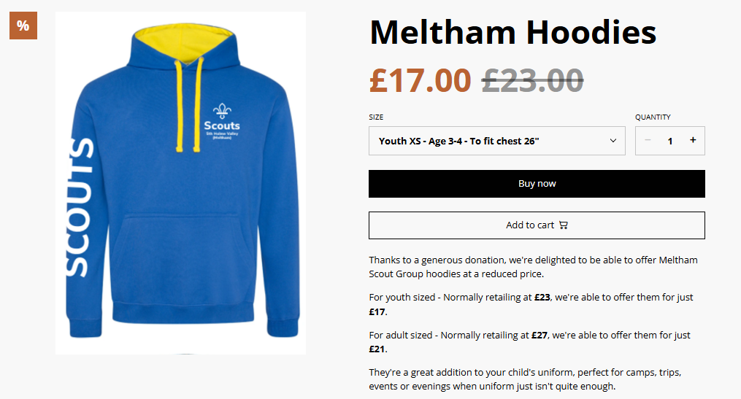
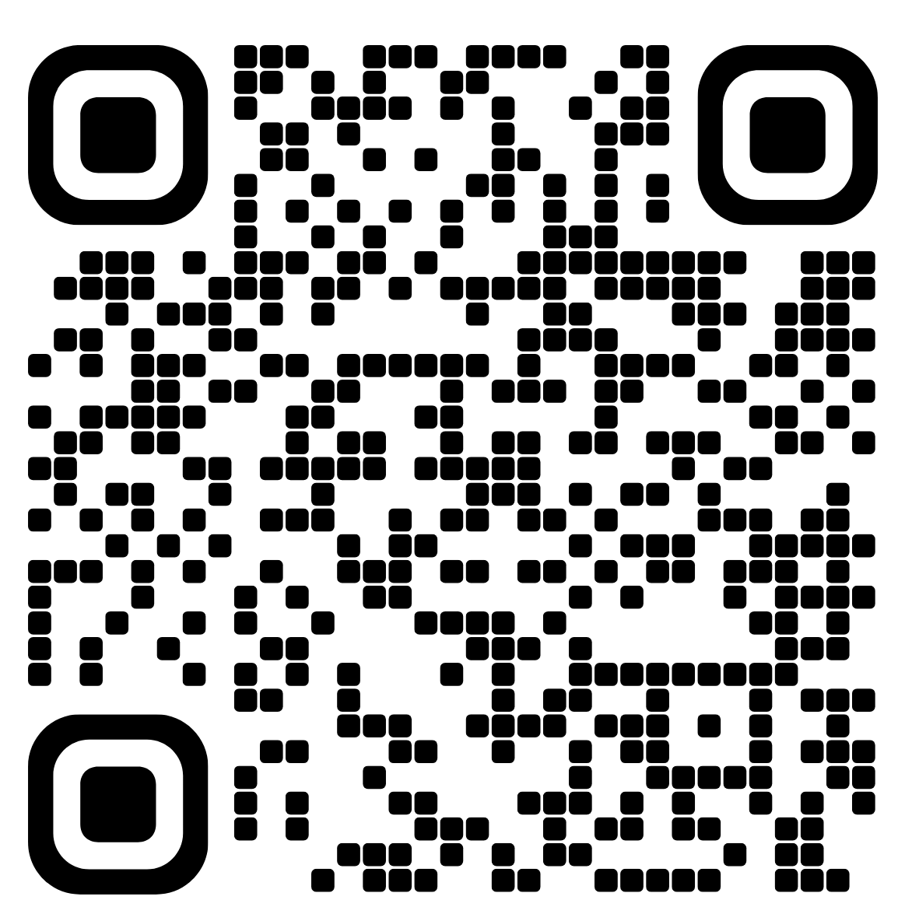
Hoodies
https://meltham-scout-group.sumupstore.com/
Notes:
Thanks to Crossroads and to Sam, we have managed to source a supply of hoodies at a reduced price.
Limited availability. Non section branded so can wear across sections.
An addition to the uniform.

Slide 17
In other news…
In 2023…
  A two year plan
    Grow the section from 4 Cubs
    Build a team
In July 2027…
  It’ll be four years
    Equivalent of two complete rotations of Cub packs
I will be stepping back from Cub Leader
But continue to support the team & the new leader(s)
Notes:
There's one other thing I want to talk about tonight.
When I took on Cubs in 2023, the plan was always that it wouldn't be forever.
We had four Cubs, we needed to grow the section and we needed to build a team around it.
I’ve had some amazing times & experiences
Including sleepover in the Deep
My role is Group Lead Volunteer
Supporting the other leaders
Group events & fundraising
Growing the group
Community awareness
I am Scouting at least 5 nights a week
I also have a family & home to look after
Finding time for other activities other than Scouting
Family rota
We're now four years on from that decision and we've effectively been through two complete rotations of the Cub Pack.
So in July 2027 I'm going to step back from being Cub Leader.
That doesn't mean I'm disappearing. I'll still be around, I'll still support the team and I'll still be Group Lead Volunteer.
But I think it's important that we continue to build the team and give someone else the opportunity to take the section forward.
This is one year’s notice to find a replacement who can shadow to learn about the role.

Slide 18
We've come a long way
2020 - 35
2021 - 36
2022 - 32
2023 - 16
2024 - 34
2025 - 52
2026 - 55
A (not so?) interesting fact
Nationally…
Young persons numbers are back to / increased on pre-covid levels
With 25% fewer volunteers!

Slide 19


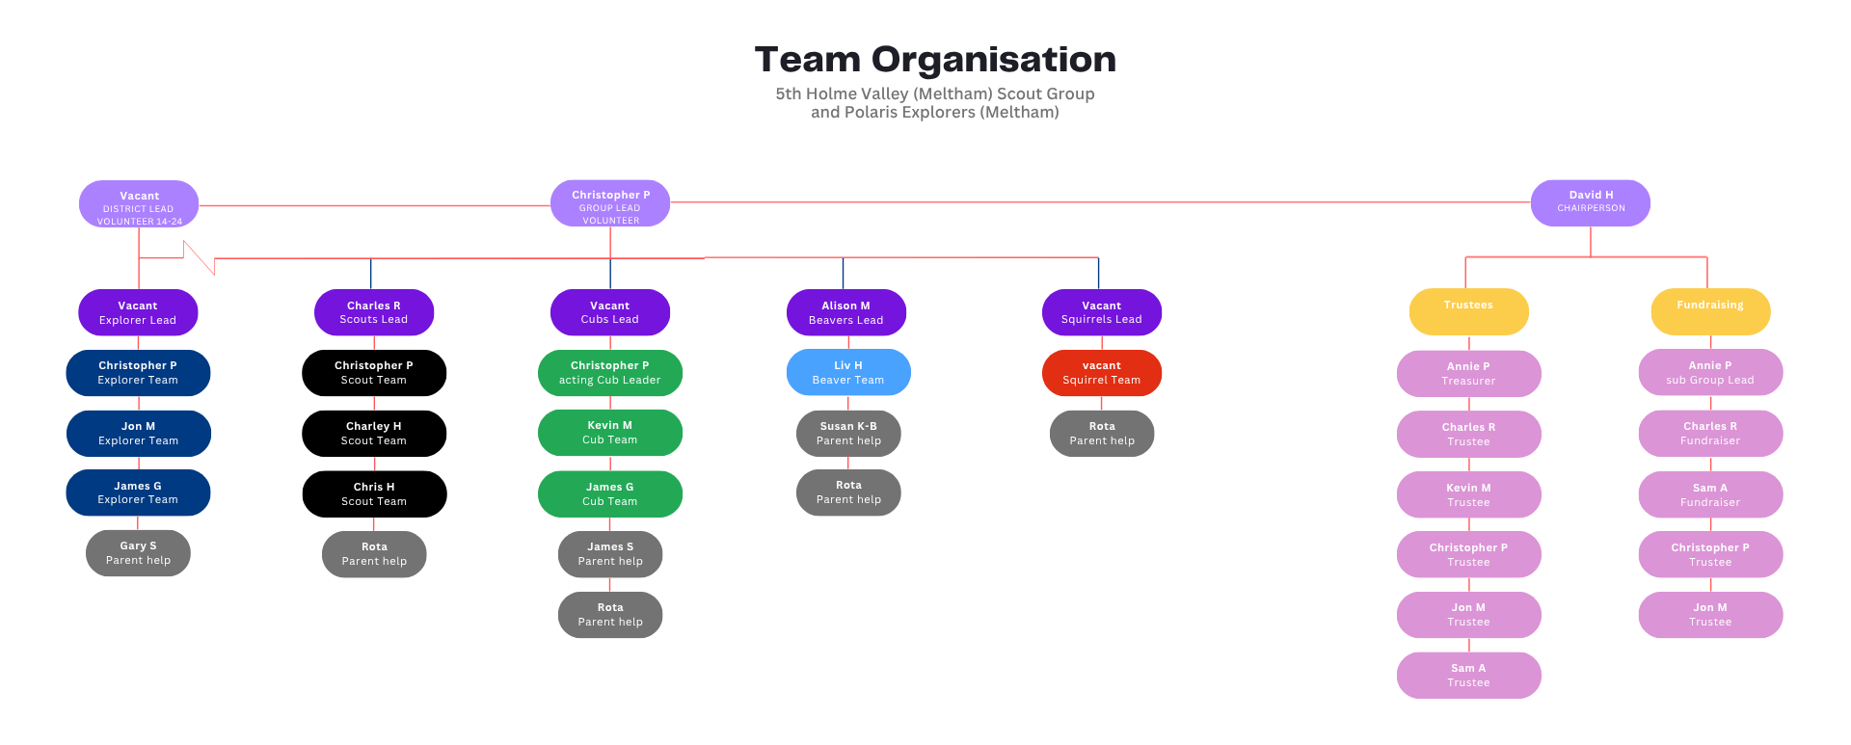
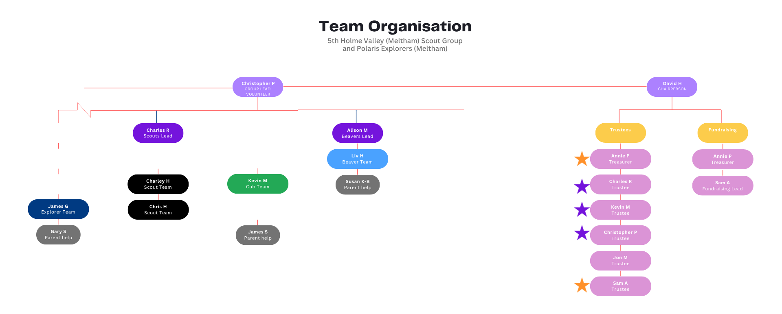
We've come a long way

Slide 20
Same drum, different beat
Not you!
  (Unless you want to volunteer! We would love to have you onboard)
We are a team of 13
We have 60 YP in the Group
  So let’s assume we have over 100 parents / carers
But you must know someone?
  Grandparents
  Aunts, uncles, cousins
Skills required:
  Friendliness
  Willing to learn
  Willing to help (even if making a brew or helping to tidy up)
Notes:
Who here was involved in Scouting or Guiding as a youngster?
No skills necessary
We can provide training

Slide 21
Contact details
Group Leadership Team
Group Trustee Board
Group Lead Volunteer
Christopher Penn
christopher.p@melthamscouts.org.uk
glv@melthamscouts.org.uk
07799 888104
Beaver Team Leader
Alison Miller
alison.m@melthamscouts.org.uk
beavers@melthamscouts.org.uk
Scout Team Leader
Charles Raply
charles.r@melthamscouts.org.uk
scouts@melthamscouts.org.uk
Group Leadership Support
Jon McCallum
jon.m@melthamscouts.org.uk
Chairman
David Heathcote
chairperson@melthamscouts.org.uk
Treasurer
Annie Parker
treasurer@melthamscouts.org.uk
Trustee
Kevin Miller
kevin.m@melthamscouts.org.uk
Fundraiser / Trustee
Sam Asquith
sam.a@melthamscouts.org.uk
fundraising@melthamscouts.org.uk
trustees@melthamscouts.org.uk

